Slide 1
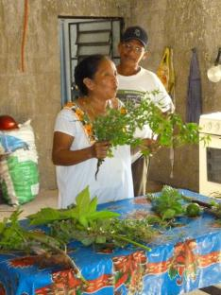
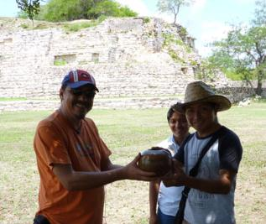
Highlights of the 2011 MACHI Bi-directional Grant
(a grant to fund cultural preservation and interchange in the Maya World)
Grant title:
“Strengthening identification between ancient ruins and
the communities of Ucí, Kancabal, and their diaspora”
Grantee:
Scott R. Hutson
Grant Coordinator:
Galvin Maciel Can Herrera

Slide 2
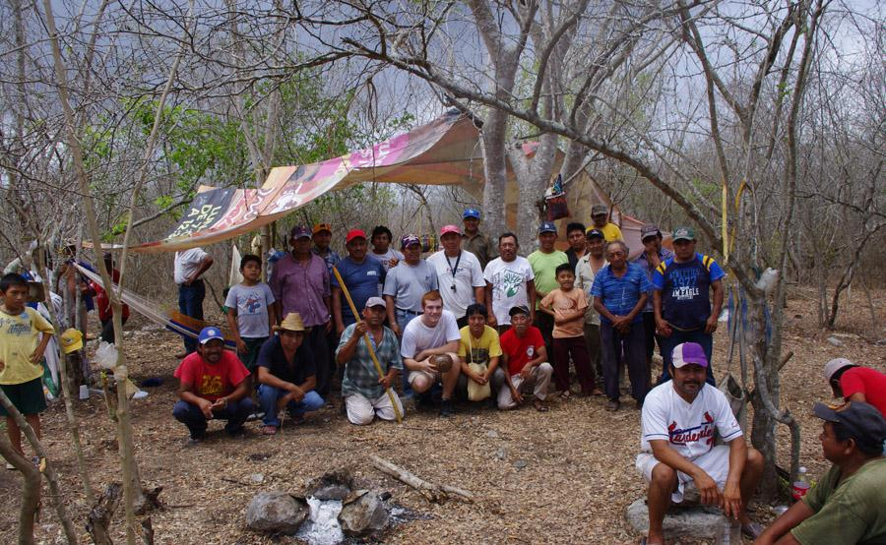
The MACHI grant funded cultural preservation and interchange initiatives that accompanied an archaeological research project (funded by other institutions) that took place in Yucatan, Mexico.
What follows is a scrapbook of newspaper articles and photos that document the initiatives of the Bi-directional grant (and, occasionally, the archaeological research).

Slide 3
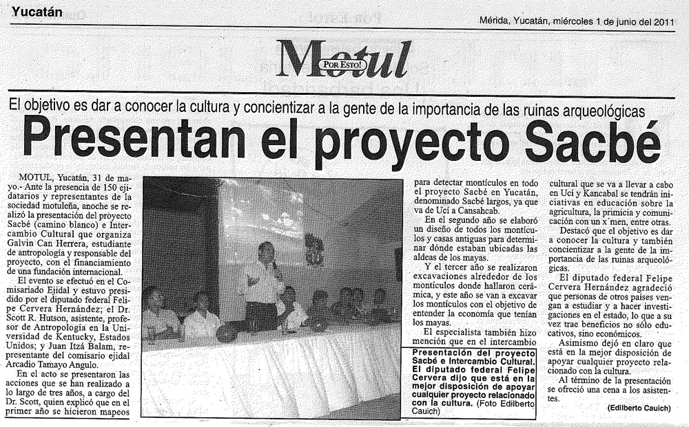
Inauguration of project, Motul, May 30th
Motul is the capital of the municipality to which Uci and Kancabal pertain
June 1st edition of ¡Por Esto! (Yucatan daily newspaper), showing Federal congressman Felipe Cervera.

Slide 4
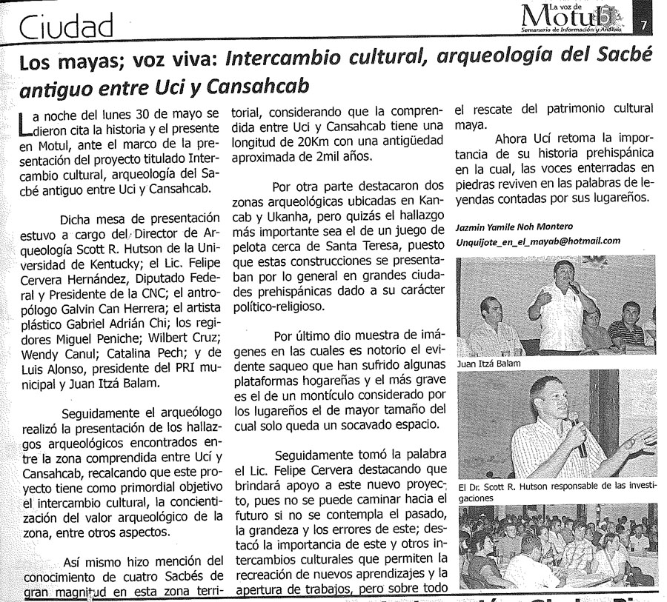
Inauguration of project, Motul, May 30th, part 2
June 1 edition of
La Voz de Motul
(weekly magazine),
showing Juan Itza
Balam, local head of the National Commision of Campesinos

Slide 5
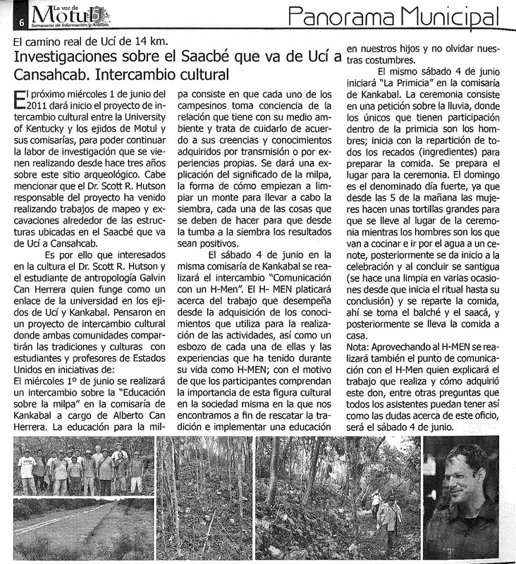
A magazine article that introduces the MACHI project and
archaeological project
May 25 edition of
La Voz de Motul
(weekly magazine)

Slide 6
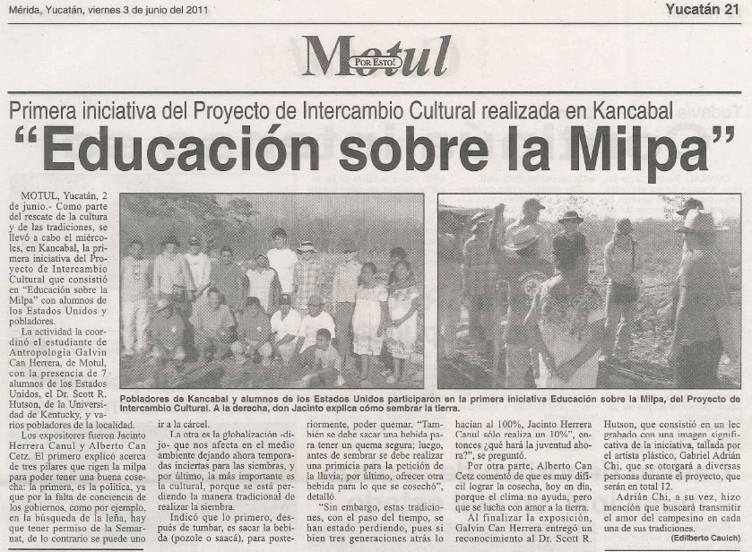
Education about traditional farming, June 1st

Slide 7
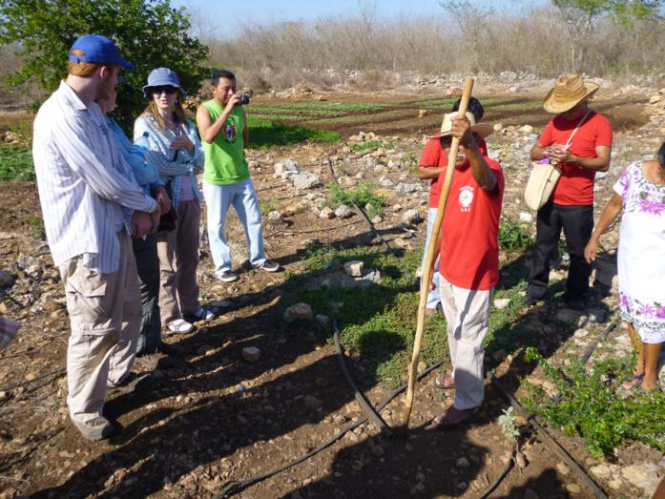
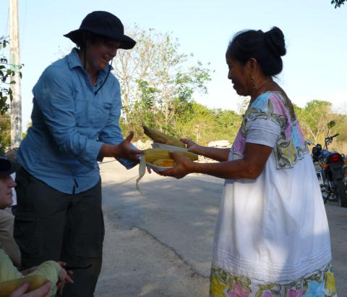
Don Jacinto Herrera
explains traditional
milpa farming
Doña Cristanda de Herrera
serves corn on the cob, tamales
and atole made from corn grown
by Don Jacinto. UK grad student
Carrie Todd receives the food.

Slide 8
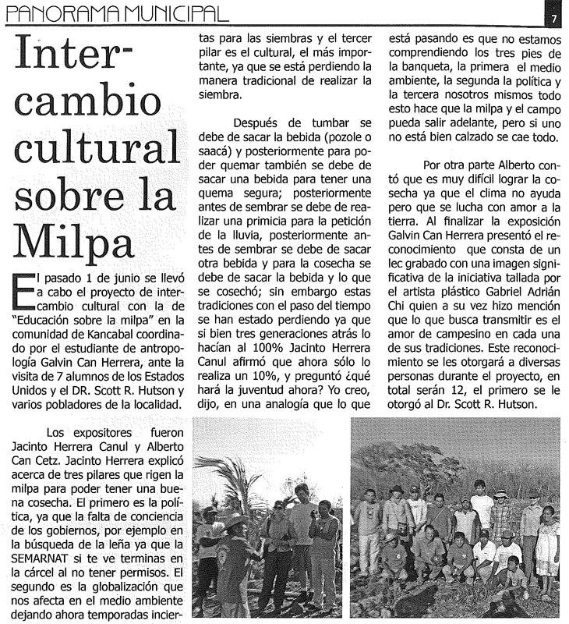
Education about traditional farming, June 1st
June 15 edition of
La Voz de Motul
(weekly magazine)

Slide 9
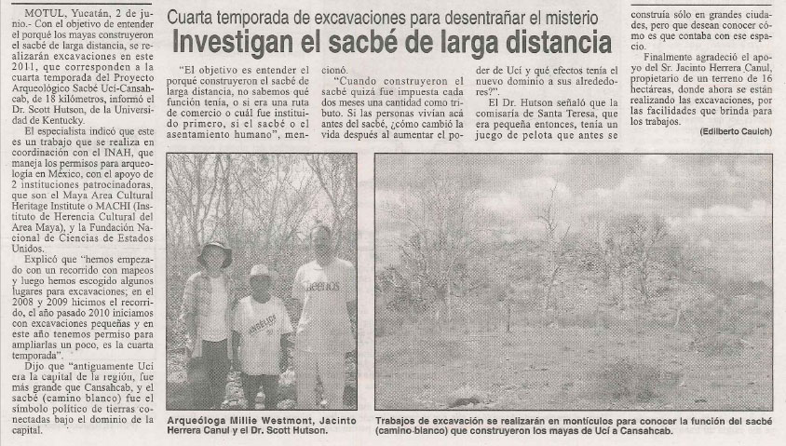
Introduction to the archaeology project
June 3rd edition of ¡Por Esto! (Yucatan daily newspaper),
picturing UK undergrad Millie Westmont at left

Slide 10
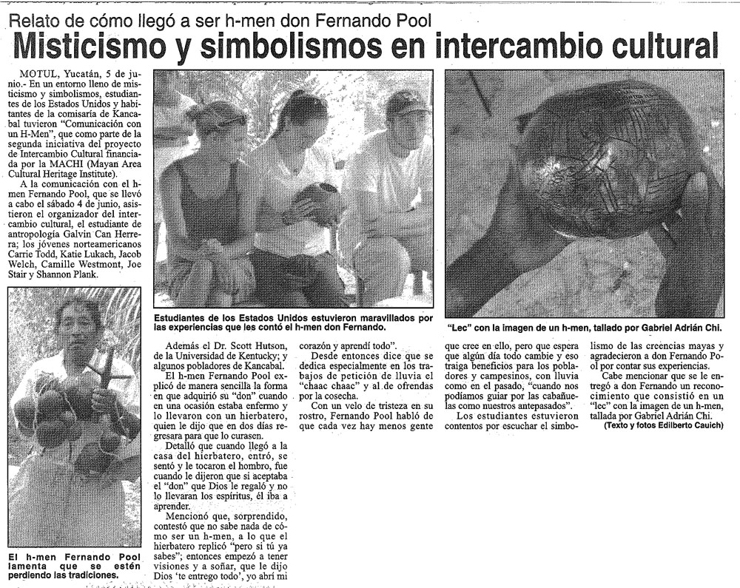
Cultural interchange with shaman, village of Kancabal, June 4
June 6 edition of ¡Por Esto!
(Yucatan daily newspaper)

Slide 11
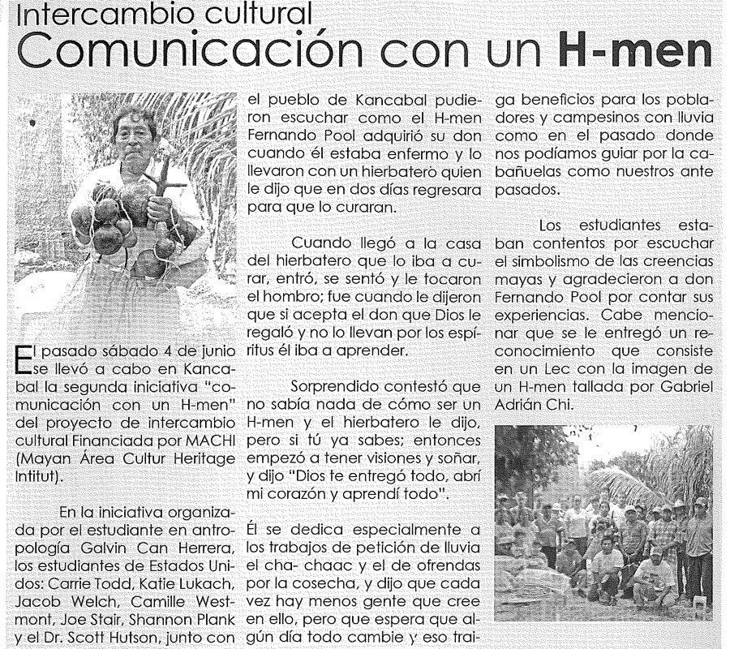
Cultural interchange with shaman, village of Kancabal, June 4
June 6 edition of
La Voz de Motul
(weekly magazine)

Slide 12
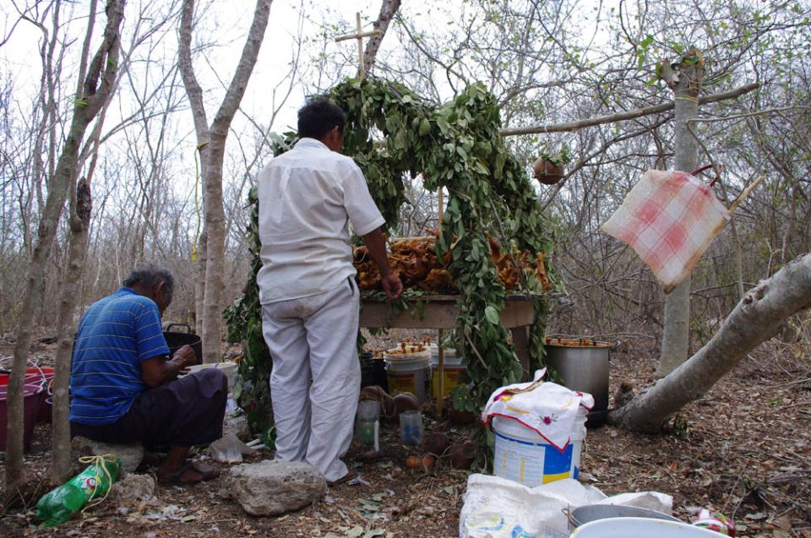
Photo from the Cha Chaak ceremony, June 5th.
In the Cha chaak, shamans ask Christian and traditional deities for rain and a good harvest.

Slide 13
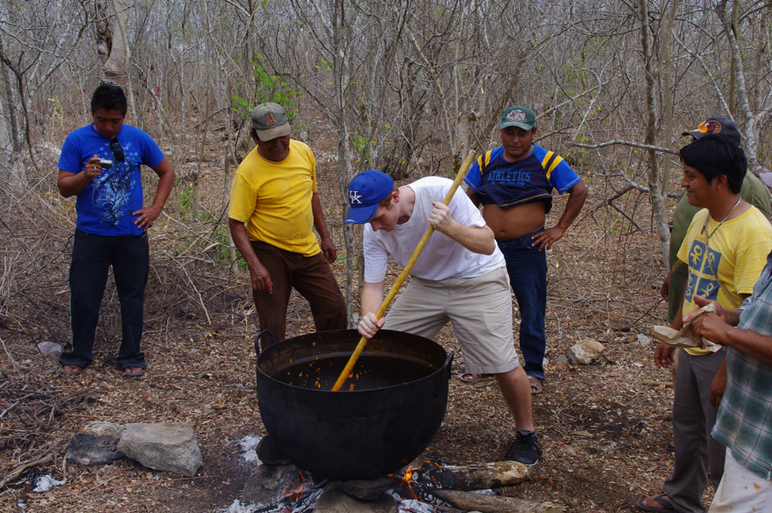
University of Kentucky undergrad Jacob Welch helping prepare utam (a thick pudding made
of corn, chili and calabash seed) at the cha chaak ceremony (grant coordinator Galvin in yellow at right)

Slide 14
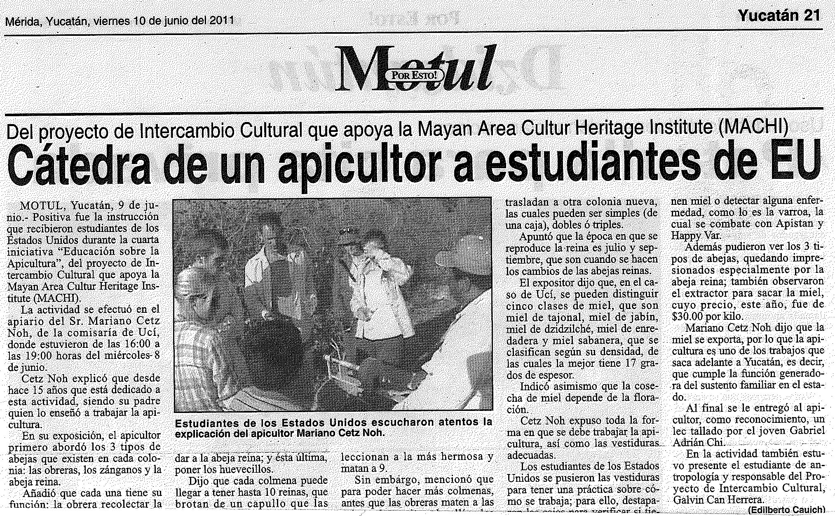
Education about beekeeping, June 8th
June 10 edition of ¡Por Esto! (Yucatan daily newspaper)

Slide 15
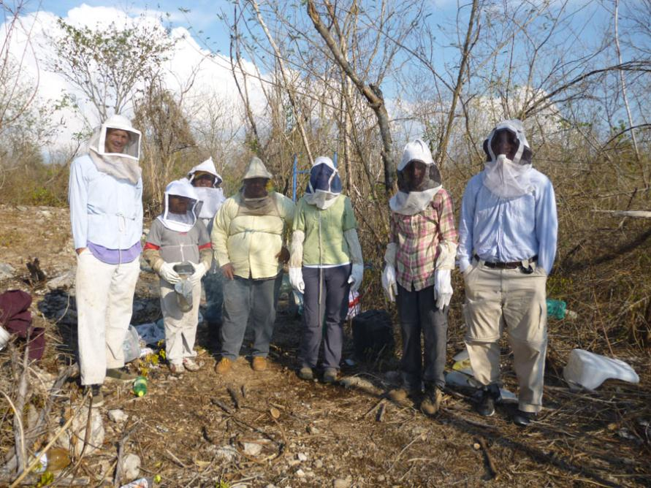
Students and professionals get ready to tend bees

Slide 16
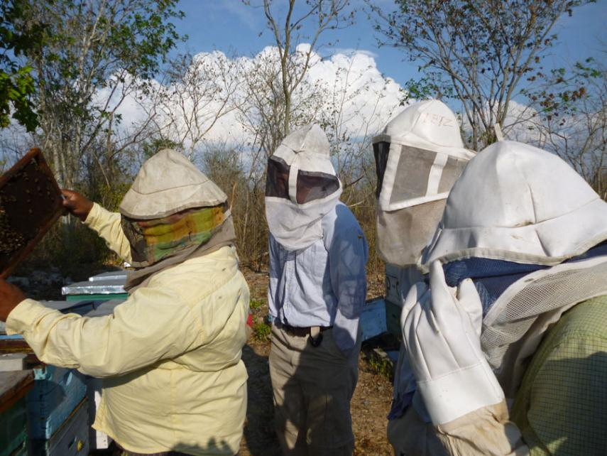
Mariano Cetz Noh, of Ucí, seeks the queen bee

Slide 17
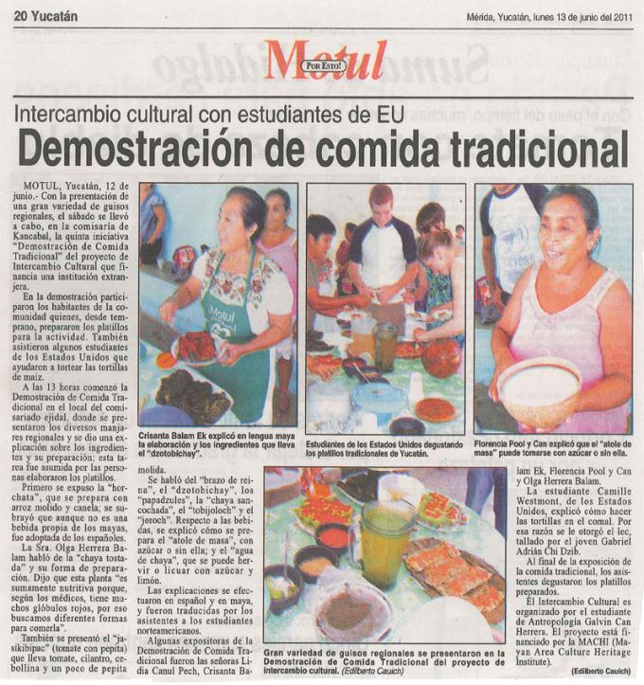
Traditional meal in
Kancabal, June 11th
June 13 edition of ¡Por Esto!
(Yucatan daily newspaper)

Slide 18
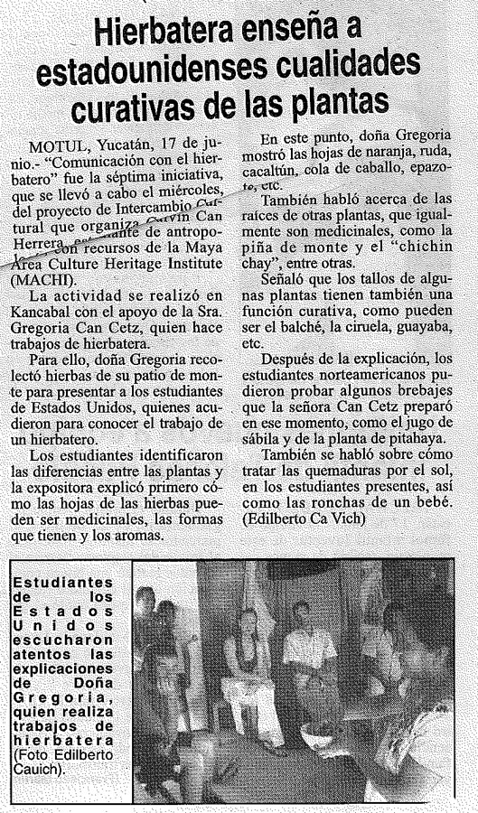
Education about local herbal medicines, June 15th
June 18 edition of ¡Por Esto!
(Yucatan daily newspaper)

Slide 19
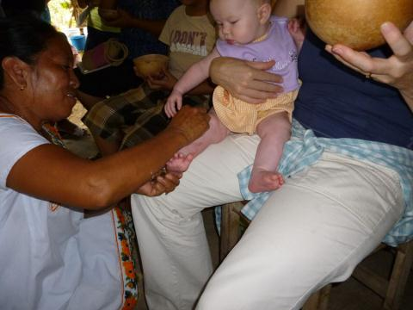
Hierbatera Doña Gregoria Can Cetz, of Kancabal,
explaining the medicinal uses of local plants.
Doña Gregoria applies crushed cacaltun leaves
to River Hutson to treat a skin rash.

Slide 20
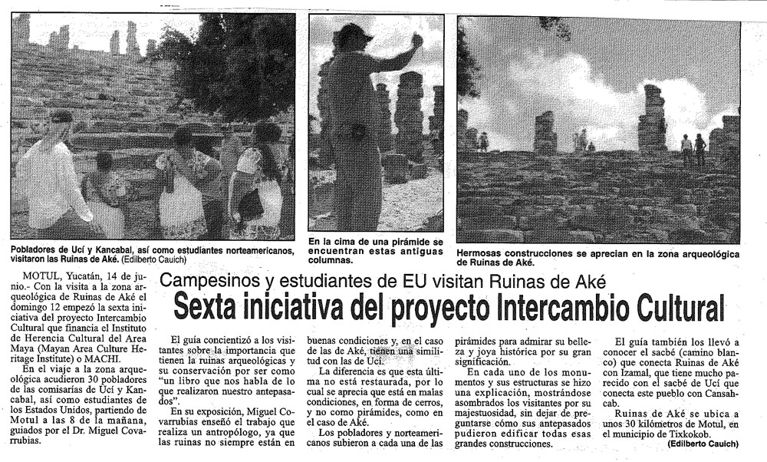
Tour of Aké with campesinos from Ucí and Kancabal, June 12th
June 15 edition of ¡Por Esto! (Yucatan daily newspaper)

Slide 21
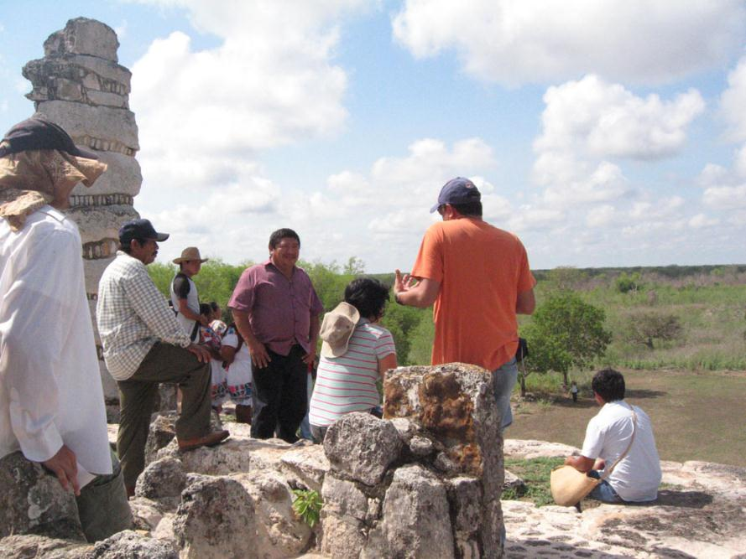
Archaeologist Miguel Covarrubias discusses Aké with campesinos from Ucí and Kancabal

Slide 22
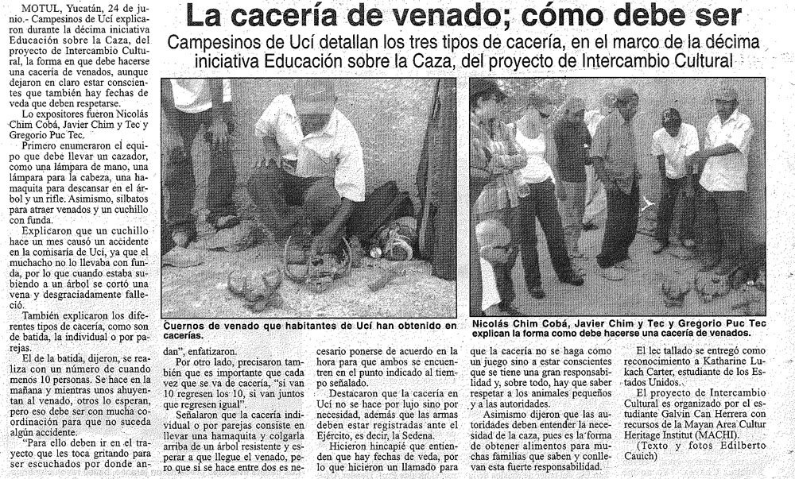
Education about traditional hunting methods, June 23rd
June 25 edition of ¡Por Esto! (Yucatan daily newspaper)

Slide 23
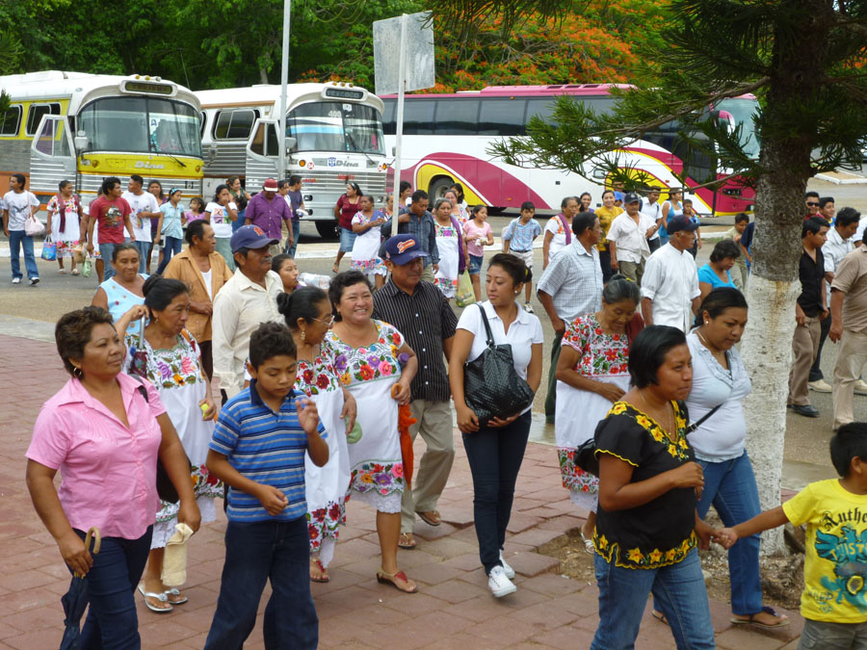
Villagers of Ucí and Kancabal getting off the two rented buses at Chichén Itzá, June 26th

Slide 24
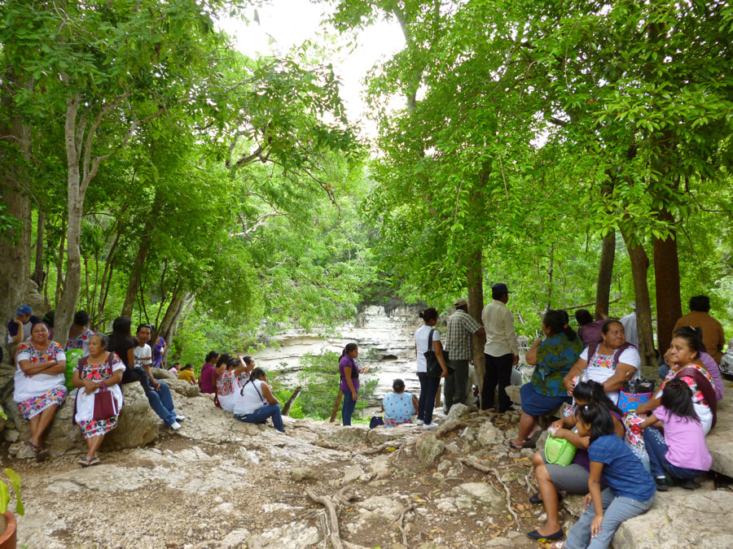
Some of the 107 villagers who came to Chichén, resting at the Cenote of Sacrifice

Slide 25
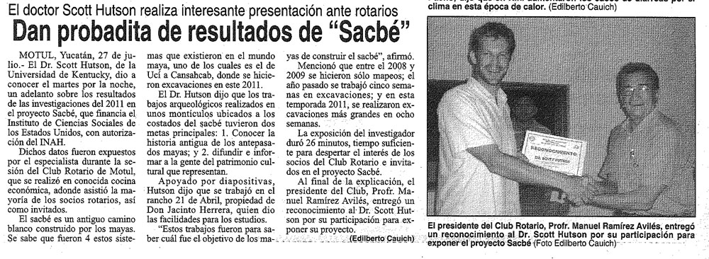
July 26th, presentation to the Motul Rotary Club, (club #7167, district 4200)
July 29 edition of ¡Por Esto! (Yucatan daily newspaper)

Slide 26
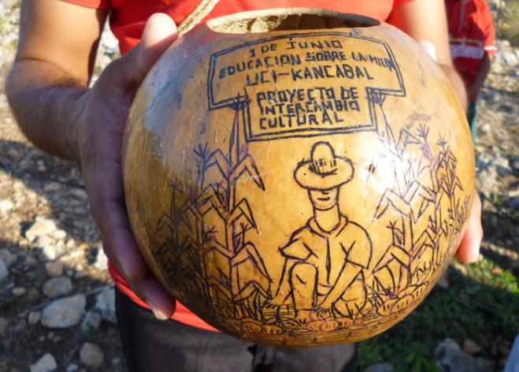
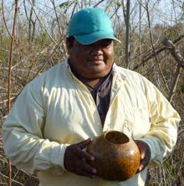
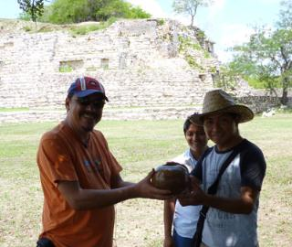
Example of an incised lek (calabash), made by Gabriel Chi Dzib, commemorating an intercambio event
Marciano Cetz Noh
showing the lek
given to him after his
beekeeping demo.
At the end of the Aké
visit, Artist Gabriel
Chi Dzib presents lek
to Miguel Covarrubias

Slide 27
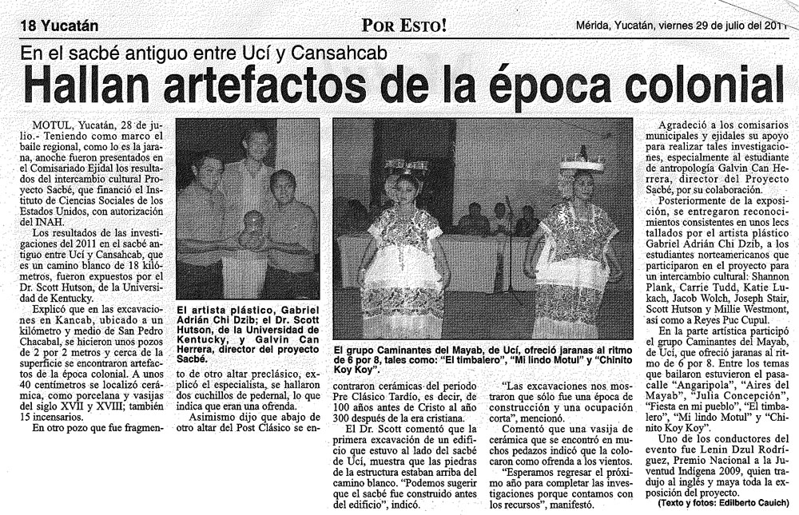
Closing ceremony at the Motul ejido building, July 27th
July 29 edition of ¡Por Esto! (Yucatan daily newspaper)

Slide 28
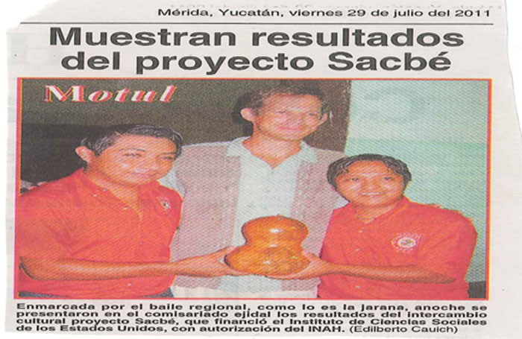
Closing ceremony at the Motul ejido building, July 27th
July 29 edition of ¡Por Esto! (Yucatan daily newspaper)
Pictured, left to right: Gabriel Adrián Chi Dzib (artist who commemorated each event with an incised calabash), Scott Hutson (project director), Galvin Masiel Can Herrera (Bi-directional Knowledge Exchange Coordinator)

